Slide 1
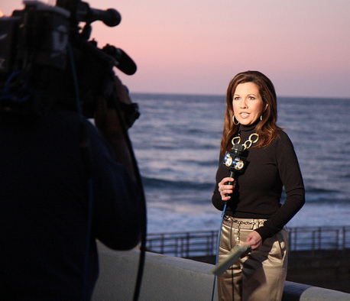
Digital Media & Communications
Storytelling
Instructor: Mr. Robbins

Slide 2
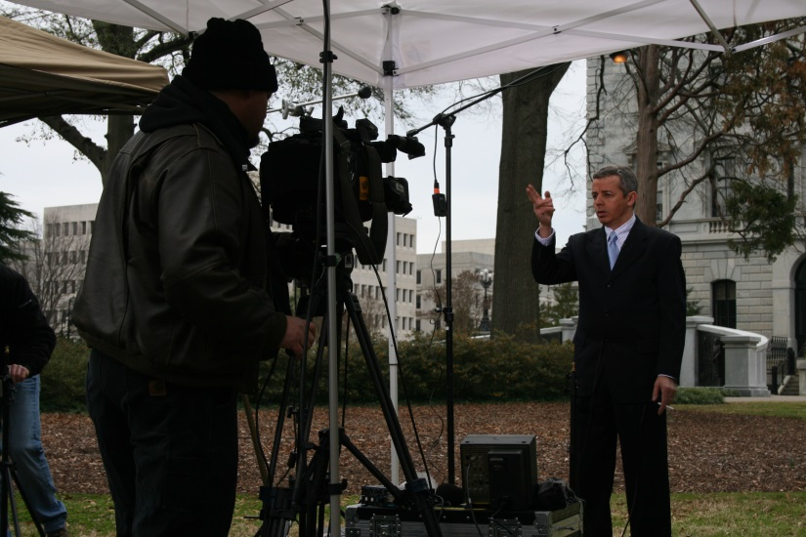
Storytelling…
FOUNDATION of ALL Mass Communication
MUST organize in logical order…
Beginning
Middle
End
Story should answer audience questions…

Slide 3
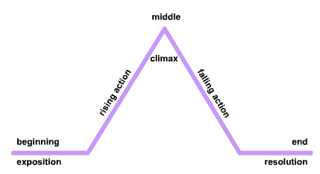
Storytelling from English Class…
Beginning
Middle
End
Who?
What?
Where?
When?
Why?
How?

Slide 4
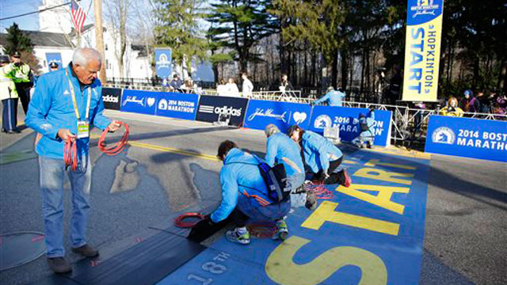
Beginning
Set the scene (Where are they?)
Broad overview of the topic (Who?)
What am I looking at?
What are they doing?

Slide 5
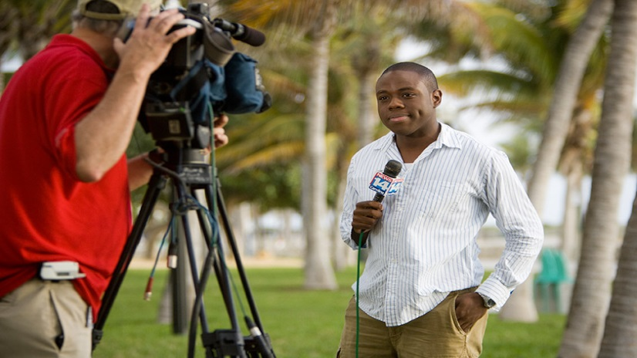
Middle
Why should I care?
Interview with an interesting view / opinion (Witness, Expert, etc.)
When is something happening?
How does it work?

Slide 6
End
When is this happening?
Recap important details
Make a point
Leave the audience wanting more

Slide 7
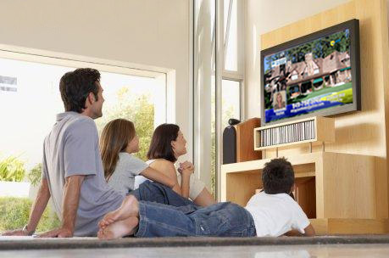
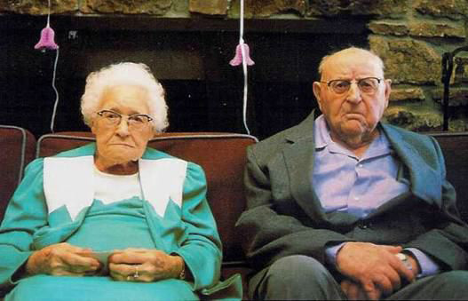
Audience
Who is watching / listening to me?
Word Choice, Pacing, Technical Expertise
Be concise, no time to waste!
Take Away. What will they remember?

Slide 8
Examples
World Cup will use goal line technology http://www.cnn.com/video/data/2.0/video/sports/2014/06/10/pkg-davies-world-cup-goal-line-tech.cnn.html
10-Year-Old Earns High School Diploma http://abcnews.go.com/GMA/video/10-year-old-earns-high-school-diploma-24079279
College Football's First Female Defensive Back http://abcnews.go.com/GMA/video/college-footballs-female-defensive-back-24068556
Hurricane Live Report http://youtu.be/T2b52iijuyQ

Slide 9
Activity / Ticket to Leave
Use Worksheet to brainstorm / plan a story about Watertown High School
Left Column: “Details” of the story divided by Beginning, Middle, End
Right Column: List of Video or Camera Shot ideas needed to tell your story
Ticket to Leave: You and your partner “pitch” me your story

Slide 10
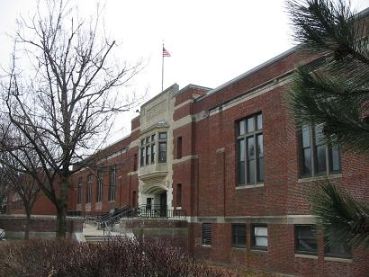
Activity / Ticket to Leave
Considered your Audience: Its someone who wants to learn about Watertown High School
Potential Topics: History, Clubs, Schedule, Students, Athletics, Mascot, Traditions, Teachers, Building Architecture, & more…
BE CREATIVE!!!

